Slide 1


Integrating Innovation and Skills

Slide 2
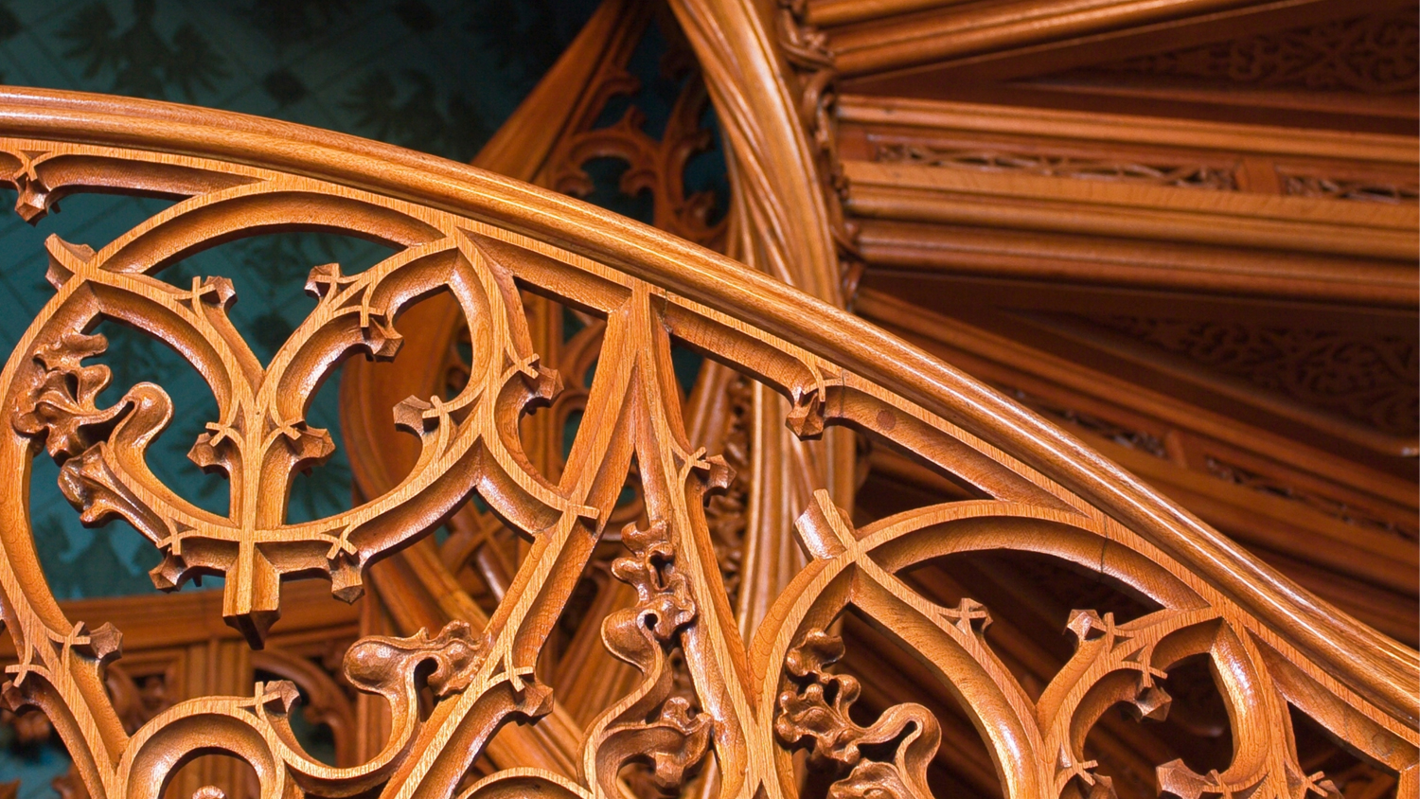
Raj Interiors aims to develop the best designs that easily meet the needs of the clients. We endeavor to create the master pieces that reach out to the mind and soul, effortlessly and effectively.

Slide 3

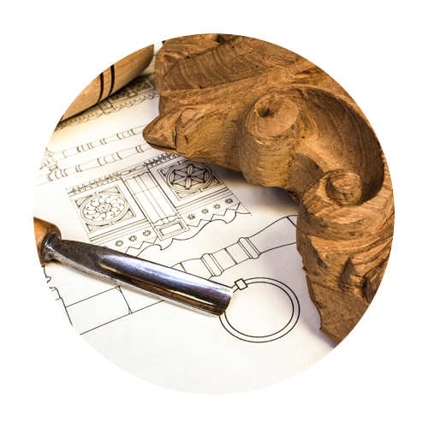
About Raj Interiors
We believe every client is unique, having his or her own choices when it comes to giving a perfect look to their space, irrespective of its size. Therefore, we present to them a plethora of options and packages, helping them in picking the one that befits their needs.
High - end restaurants, hotels, hotel residences, villas and others relying on us, we are dedicated to offer nothing but the best.
We have a team of highly adept and artistic designers, we have been able to cater to all the crucial elements that include architecture and space, form and material, colors and designs.
www.rajinterior.co.in | info@rajinterior.co.in
3

Slide 4




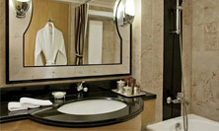
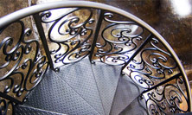
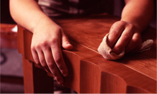
1
Varied forms of intricate classical furniture work like carving, engraving, molding.
4
Glass work such as Toughening, bending, fusion, etching, carving etc
CREATING
INNOVATIVE
SERVICE
2
5
Painting work that includes plastic, velvet, lesture & texture painting.
P.O.P work including Punning, Ceiling, Molding, gypsum partition & Gypsum work.
3
6
Civil Work like flooring, cladding, fine art work in Marble, bissaza, Granite, Italian marble with inlay, carving, molding etc.
Fabrication of all sorts of metal like M.S, S.S, Brass, White metal with laser cut, water jet cut etc.
7
Polishing work like France polish, Melamine, P.U. & Masters in Lamination.

Slide 5
Projects
Name of the project | Project | Amount | Architect
Citrus Hotels, Pune | Guest Rooms & Toilets Restaurant / central kitchen & conference hall Banquet Hall and pre function Area Ground floor/ Terrace | 145 lacs 78 lacs 232 lacs | M/S Designers Group, Mahim
Hotel Kenilworth Beach | Guest Rooms & Toilet Corridor Banquet Hall Coffee Shop & Bar Health Club Discotheque & Casino Lobby Malika Restaurant Entrance Porch | 326 Lacs 103 Lacs 45 Lacs 135 Lacs 85 Lacs 39 Lacs 65 Lacs 48 Lacs | M/s. Shakti Parmar & Assoc Rehem Mansion Colaba, Bombay M/s. Prakash Mankar & Associates Bombay T.I.D. Associates Pvt. Ltd. 22-B Mosque Street,Singapore
Resort, Utorda, Goa | Head office at Nariman Point (Dalamal House) | 69 Lacs | M/s. Collaborative Architecture, Worli Naka, Mumbai.

Slide 6
Projects
Name of the project | Project | Amount | Architect
Hotel Majorda Beach Resort, Majorda, Goa. | Guest Rooms & Toilet (Village Street) Conference Hall Laguna Restaurant & Tea Longue | 193 lacs 59 lacs 45 lacs | M/s. Shakti Parmar & Assoc Rehem Mansion,Colaba, Mumbai M/s. Design Research 10th Rd. JVPD, Juhu,Mumbai M/s. Shakti Parmar & Assoc Rehem Mansion,Colaba, Mumbai
Citrus Hotels, Goa | Guest Rooms & Toilets Restaurant / central kitchen & conference hall | 228 Lacs 194 Lacs | M/s. Shilpi Creations Parel, Mumbai
Nerul Gymkhana, Nerul , New Mumbai | Health Club /Multipurpose Room Sports Bar & Restaurant Gymnasium Amphitheater | 268 Lacs | Suchita Sayaji Nerul New Mumbai
Citrus Hotels, lonavala | Guest Rooms & Toilets Restaurant / central kitchen & conference hall. | 426 Lacs 45 Lacs | M/s. Shilpi Creations Parel, Mumbai
Hotel Jass Oberoi Khajuraho, Madhya Pradesh | Guest Rooms & Toilet | 43 Lacs | M/s. Shakti Parmar & Assoc Rehem Mansion,Colaba, Mumbai

Slide 7
Projects
Name of the project | Project | Amount | Architect
Hotel Holiday Inn Balraj Sahani Marg, Juhu Bombay-49 | Guest Rooms & corridor Guest Rooms & corridor Coffee Shop (Side Walk) Chinese Rest & Corridor Sampan Health Club Club Select Room | 129 lacs 80 lacs 58 lacs 55 Lacs 62 Lacs 23 Lacs | M/s. Shakti Parmar & Assoc Rehem Mansion, Colaba, Mumbai M/s. Design Research 10th Rd. JVPD, Juhu ,Mumbai. M/s. Allen Gilbers (Australia) under supervision of M/s. P.G. Patki & Assoc. Fort, Mumbai M/s. Beant Seavren & Assoc. (American) under supervision of M/s. Nosar wadia & Assoc. Mumbai
Hotel Regency, Dhole Patil Road,Pune. | Guest Rooms & Toilet Banquet Halls Restaurant | 107 Lacs 47.5 Lacs 29 Lacs | M/s. Shakti Parmar & Assoc Rehem Mansion Colaba, Mumbai
Pramod (Atria Mall Worli) | Garment Show Room (Atria Mall Worli) | 63 Lacs | M/s. Shilpi Crations Parel Mumbai

Slide 8
Projects
Name of the project | Project | Amount | Architect
Marwar Hotels Ltd. Jodhpur, Rajasthan | Guest Rooms & Toilet Suite Rooms Lobby Restaurant Entrance Porch & Business Center | 125 lacs 60 Lacs 47 Lacs 35 Lacs 22 Lacs | M/s. Shakti Parmar & Assoc Rehem Mansion Colaba, Mumbai
Promod (Atria Mall Worli) | Garment Show Room (Atria Mall Worli) Lasenza Show Room (Atria Mall Worli) | 63 Lacs 89 Lacs | M/s. Shilpi Creations Parel Mumbai
Russell Street, 224/6 Road Canada, U.S.A. | Lounge Bar | 28 Lacs | M/s. Shilpi Creations Parel Mumbai
Atlanta | Tadaka Restaurant | 27 Lacs | M/s. Shilpi Creations Parel Mumbai
British Airways (International Airport) | Premium Check Inn / Back Office | 68 Lacs | D.A. Designs Lokhandwala Complex, Mumbai
Gulf Airways (International Airport) | Back Office | 19 Lacs | D.A. Designs Lokhandwala Complex, Mumbai

Slide 9
Projects
Name of the project | Project | Amount | Architect
Rajdhani Restaurant, Ahmadabad | Restaurant with kitchen | 53 lacs | A Group design, Santacruz west, Mumbai.
Rajdhani Restaurant R City Mall, Ghatkopar | Restaurant with kitchen | 53 lacs | A Group design, Santacruz west, Mumbai.
Rajdhani Restaurant, Phoenix Mall | Restaurant with kitchen | 42 lacs | Space & People Designer, Juhu
Rajdhani, Bangalore | Restaurant | 47 lacs | Space & People Designer, Juhu
Rajdhani, Pune | Restaurant | 49 lacs | Space & People Designer, Juhu
Manchester United , Pune | Restaurant | 97 Lacs | M/s. Shilpi Crations, Parel, Mumbai
Manchester United R City Mall, Ghatkopar | Restaurant | 97 Lacs | M/s. Shilpi Crations Parel Mumbai
Hyatt Regency, Ahmedabad | Back of the House Naman | 313 lacs | HBA Dubai
Naman Midtown, Worli | Typical Lift Lobbies Area | 679 Lacs | Studio HBA , New Delhi

Slide 10
Projects
Name of the project | Project | Amount | Architect
Citrus Hotel, Lonavlala | Guest Rooms | 128 Lacs | I & I Designs Mahim
Manchester United Vivacity Mall, Thane | Restaurant | 97 Lacs | M/s. Shilpi Creations Parel Mumbai
Ping Pong BKC, Mumbai | Restaurant | 89 Lacs | Mach Architektur Zurich
Sofitel Hotel BKC, Mumbai | Guest Rooms Ball Room / Pre function Hall BOH Area | 892 Lacs 180 Lacs 220 Lacs | IMA, Singapore
Hotel Novotel, Juhu | Guest Rooms, Toilets & Corridors Banquet Hall / pre function area / meeting room Office Block | 350 Lacs 193 Lacs 59 Lacs | IMA, Singapore
Hotel The Kenilworth, 1 & 2 Russel Street, Kolkatta | Guest Rooms & Toilets | 163 Lacs | M/s. Shakti Parmar & Assoc Rehem Mansion Colaba, Mumbai

Slide 11










Client List
www.rajinterior.co.in | info@rajinterior.co.in
9

Slide 12









Client List
www.rajinterior.co.in | info@rajinterior.co.in
10

Slide 13
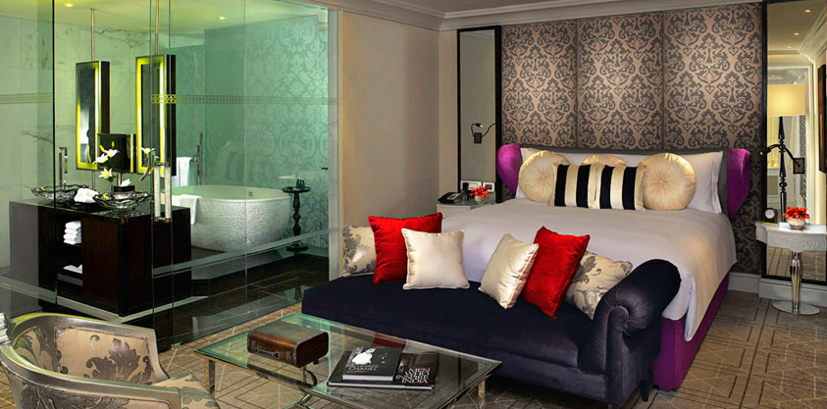
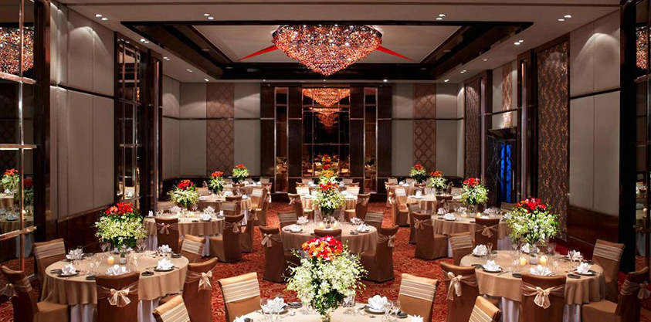
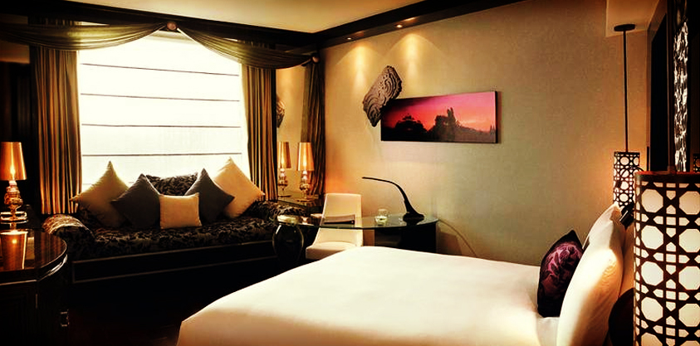

(Click on the image / spacebar to view photo gallery)
Banquet Hall
Rooms
Architect: IMA, Singapore
www.rajinterior.co.in | info@rajinterior.co.in
11

Slide 14
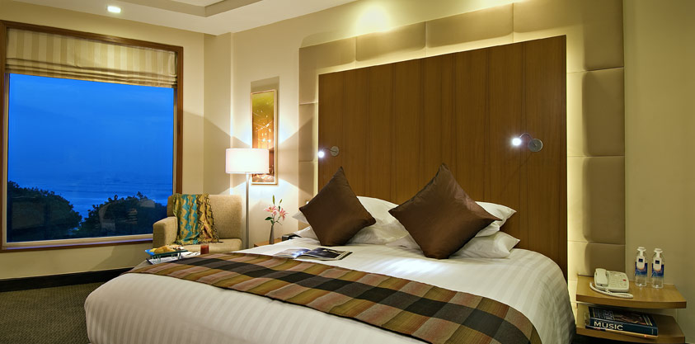
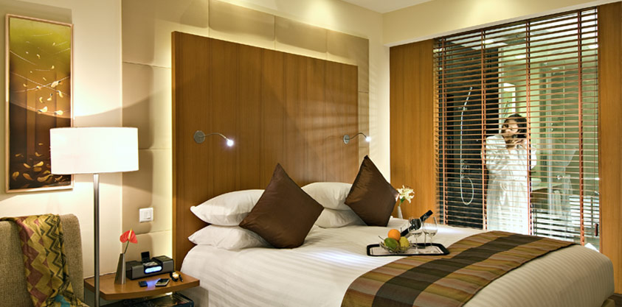
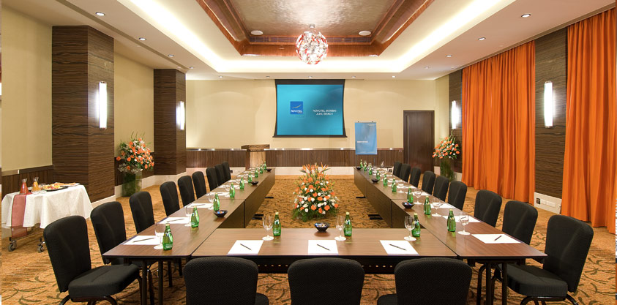
(Click on the image / spacebar to view photo gallery)
Rooms
Banquet Hall
Architect: IMA, Singapore
www.rajinterior.co.in | info@rajinterior.co.in
12

Slide 15
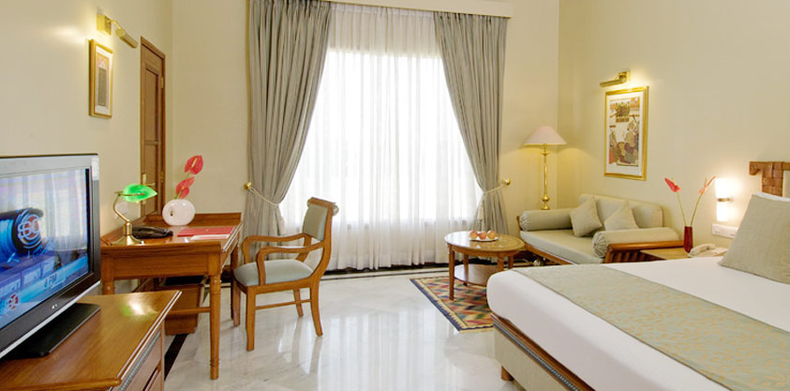
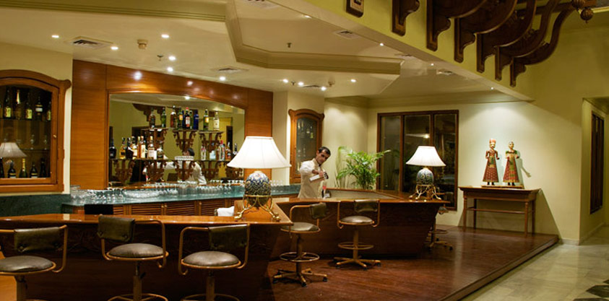
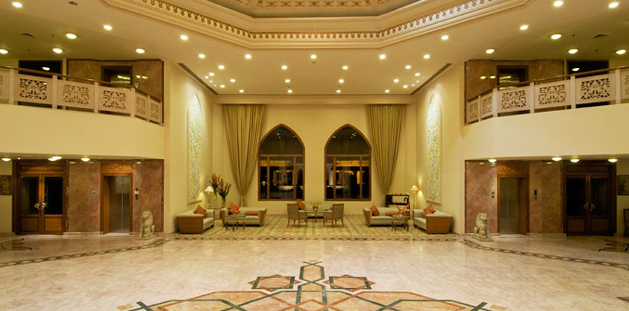
(Click on the image / spacebar to view photo gallery)
Lobby
Banquet Hall
Rooms
Architect: IMA, Singapore
www.rajinterior.co.in | info@rajinterior.co.in
13

Slide 16
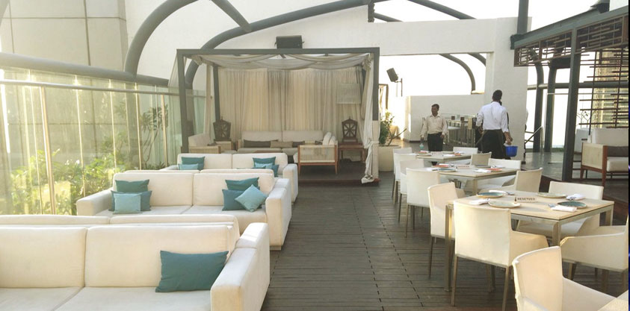
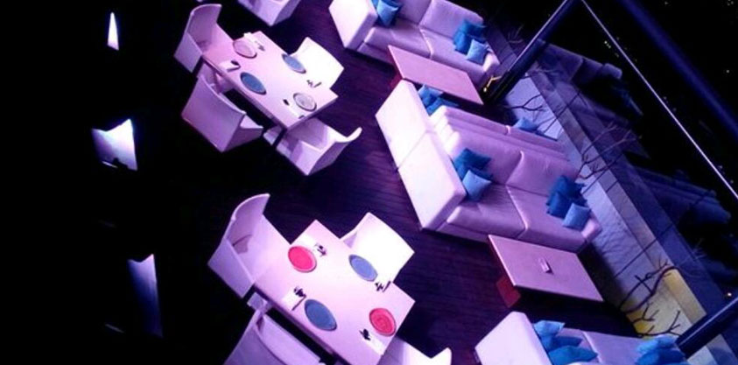
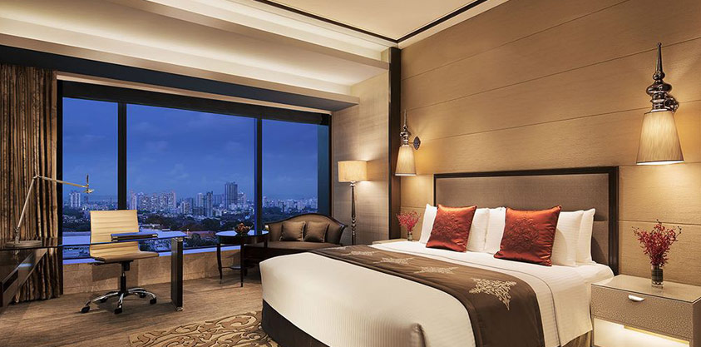
(Click on the image / spacebar to view photo gallery)
Restaurant
Rooms
Architect: IMA, Singapore
www.rajinterior.co.in | info@rajinterior.co.in
14

Slide 17
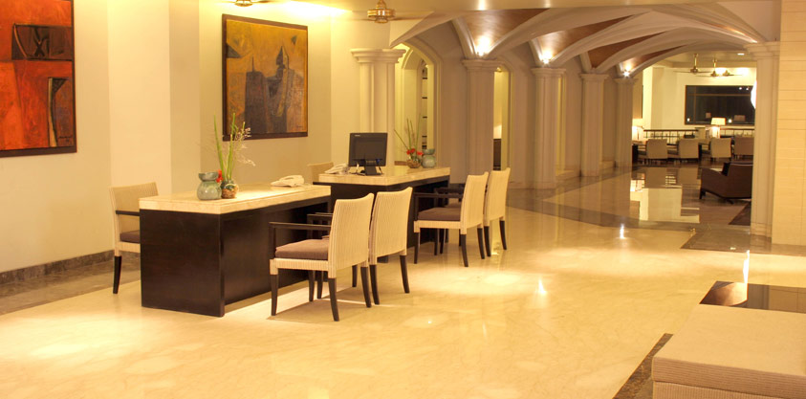
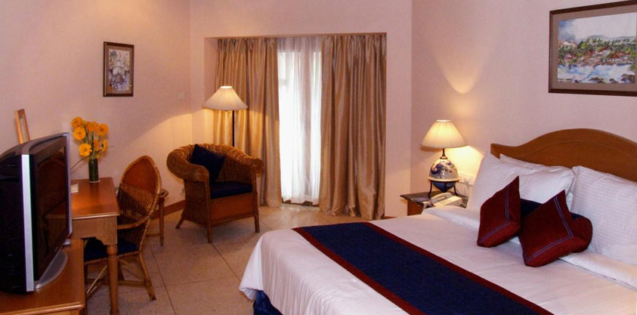
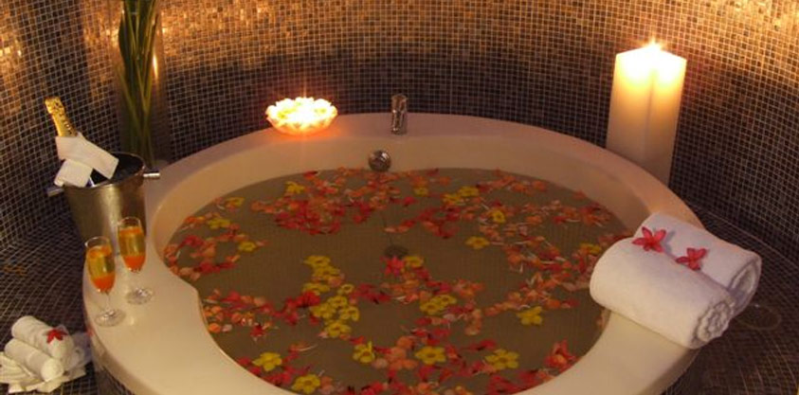
(Click on the image / spacebar to view photo gallery)
Rooms
Lobby
Banquet Hall
Restaurant
Spa
Others
Architect: M/s. Shakti Parmar & Assoc .Rehem Mansion Colaba, Bombay
www.rajinterior.co.in | info@rajinterior.co.in
15

Slide 18
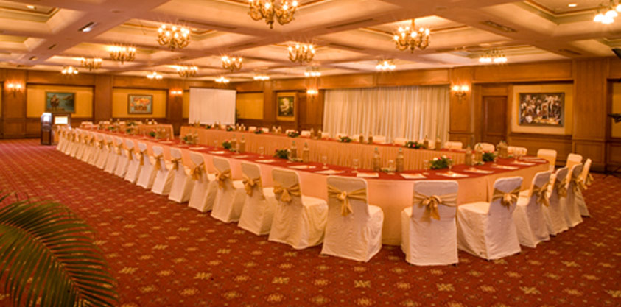
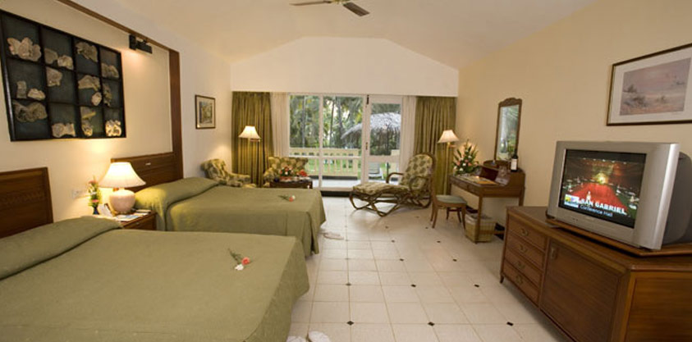
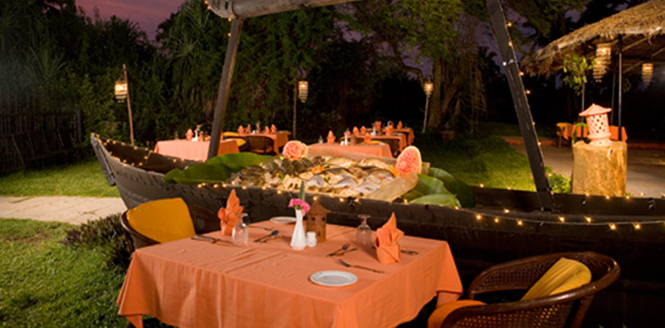
(Click on the image / spacebar to view photo gallery)
Rooms
Banquet Hall
Restaurant
Architect: M/s. Shakti Parmar & Assoc. Rehem Mansion Colaba, Mumbai
www.rajinterior.co.in | info@rajinterior.co.in
16

Slide 19
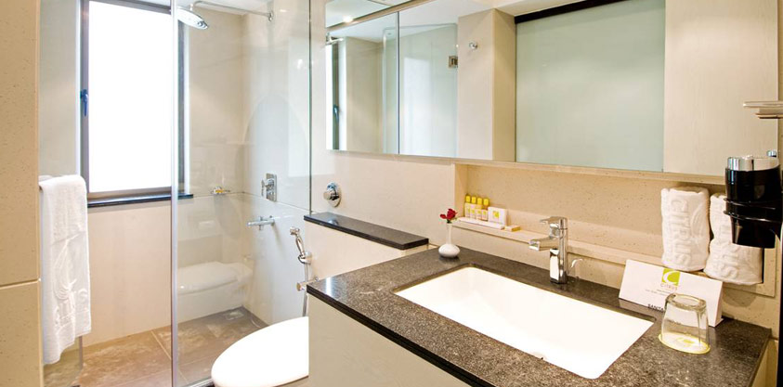
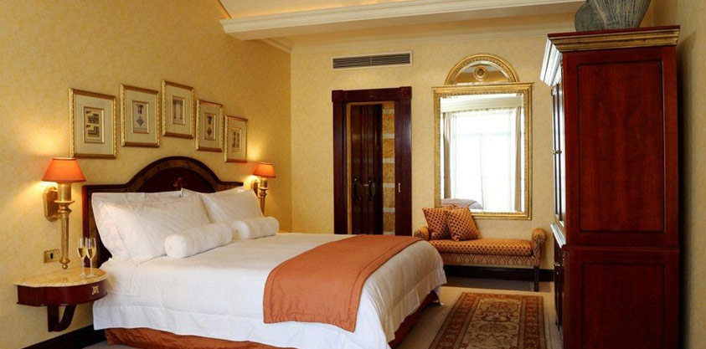
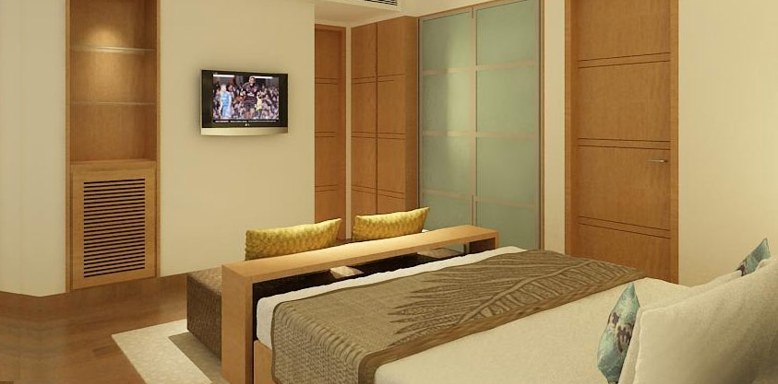
(Click on the image / spacebar to view photo gallery)
Lonavala
Pune
Goa
Architect: Lonavala - I & I Designs Mahim, Pune - M/S Designers Group,Mahim, Goa - M/s. Shilpi Creation Parel, Mumbai
www.rajinterior.co.in | info@rajinterior.co.in
17

Slide 20
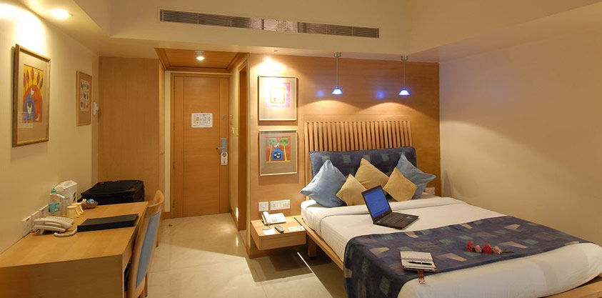
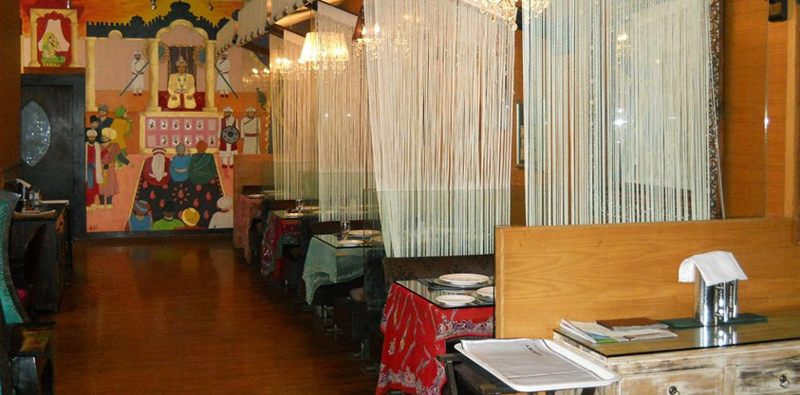
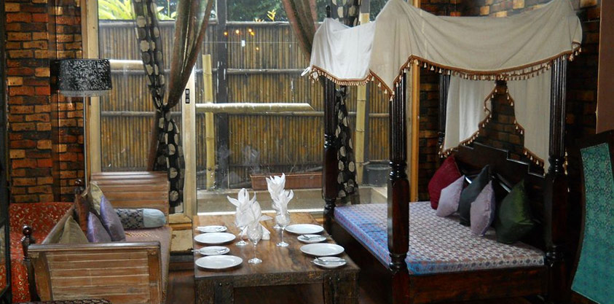
(Click on the image / spacebar to view photo gallery)
Rooms
Restaurant
Architect: IMA, Singapore
www.rajinterior.co.in | info@rajinterior.co.in
18

Slide 21
(Click on the image / spacebar to view photo gallery)
Rooms
Restaurant
Architect: IMA, Singapore
www.rajinterior.co.in | info@rajinterior.co.in
19

Slide 22
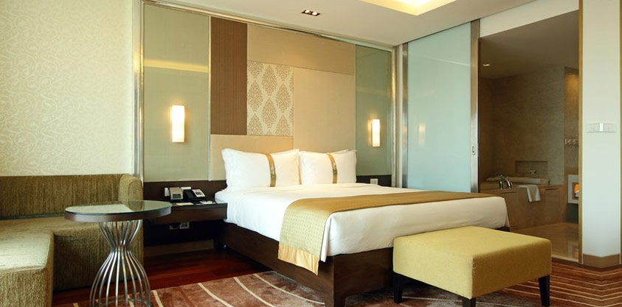
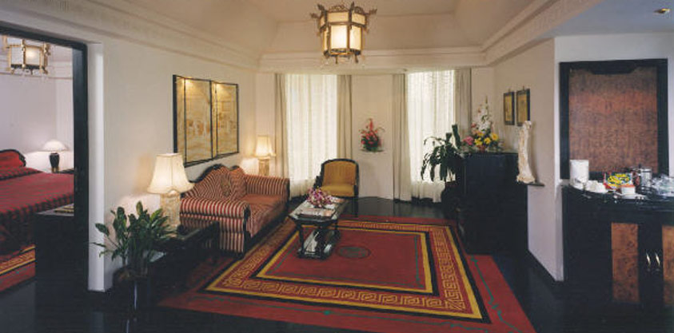
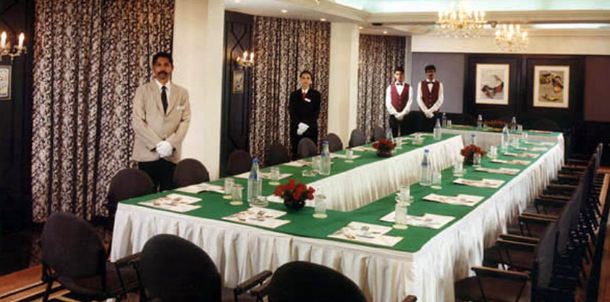
(Click on the image / spacebar to view photo gallery)
Rooms
Suites
Banquets
Architect: M/s. Shakti Parmar & Assoc Rehem Mansion Colaba, Mumbai.
M/s. Design Research 10th Rd. JVPD, Juhu, Mumbai.
M/s. Allen Gilbers(Australia) undersupervision of M/s. P.G.Patki & Assoc. Fort,Mumbai.
M/s. Beant Seavren &Assoc. (American)under supervision of M/s. Nosar wadia & Assoc. Mumbai.
www.rajinterior.co.in | info@rajinterior.co.in
20

Slide 23
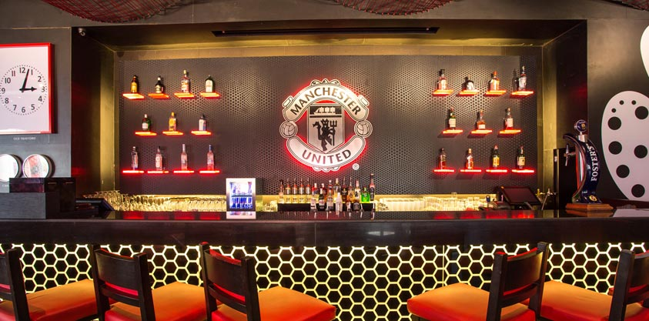
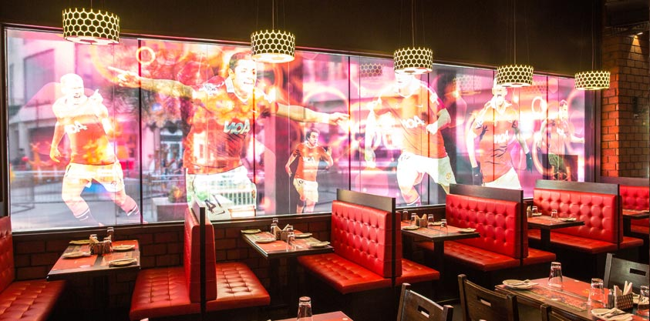
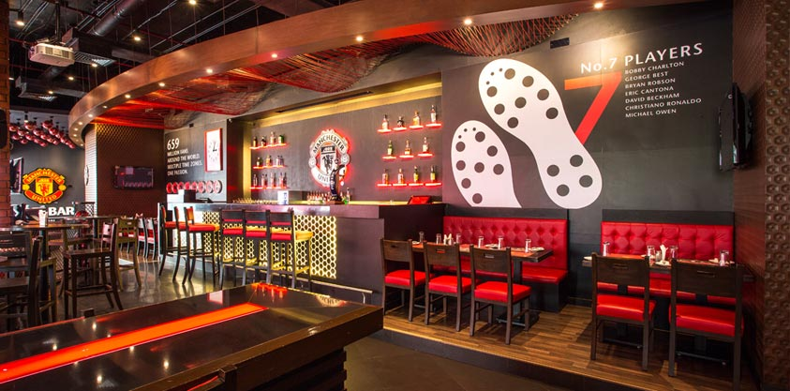
(Click on the image / spacebar to view photo gallery)
Pune - Restaurant
Architect: M/s. Shilpi Crations Parel Mumbai
www.rajinterior.co.in | info@rajinterior.co.in
21

Slide 24
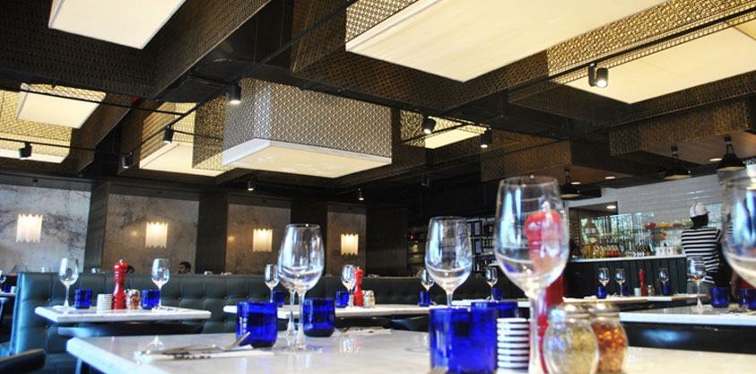
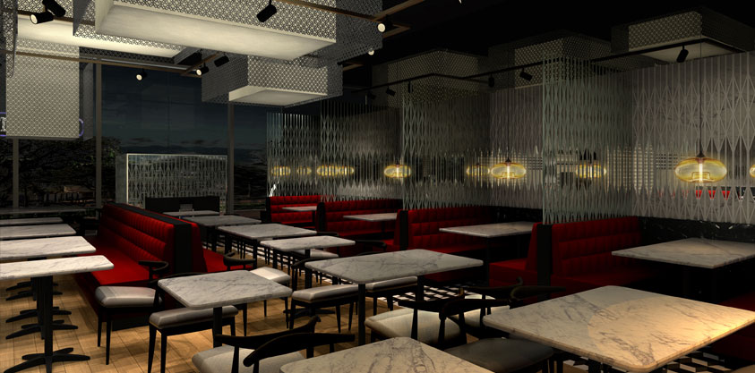
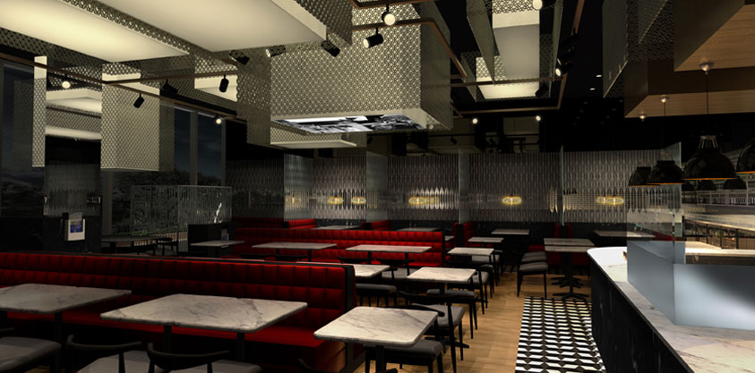
(Click on the image / spacebar to view photo gallery)
Architect: IMA, Singapore
www.rajinterior.co.in | info@rajinterior.co.in
22

Slide 25
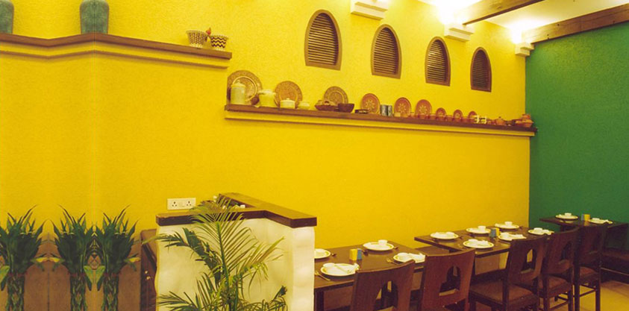
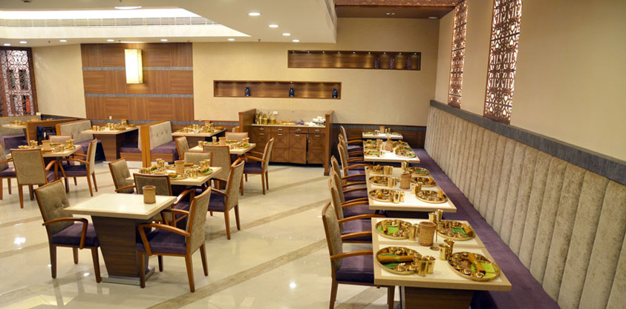
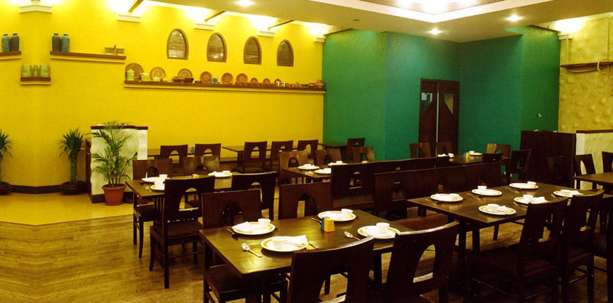
(Click on the image / spacebar to view photo gallery)
Ahmadabad- Restaurant with kitchen
Architect: A Group design, Santacruz west, Mumbai.
Space & People designer, Juhu
M/s. Shilpi Crations Parel Mumbai
www.rajinterior.co.in | info@rajinterior.co.in
23

Slide 26
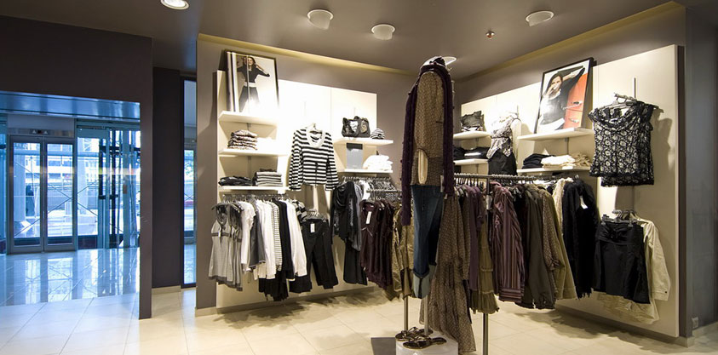
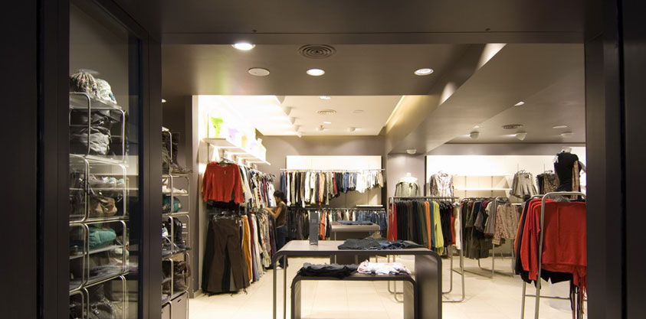
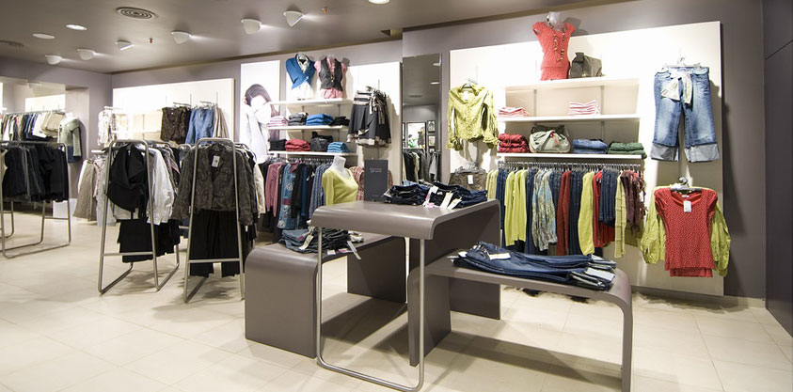
(Click on the image / spacebar to view photo gallery)
Garment Show Room
Lasenza Show Room
Architect: M/s. Shilpi Creations Parel, Mumbai
www.rajinterior.co.in | info@rajinterior.co.in
24

Slide 27
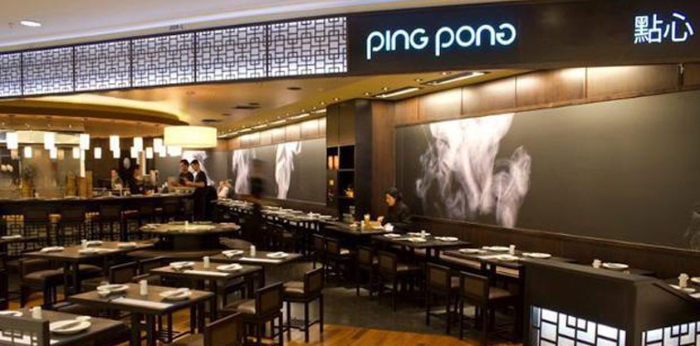
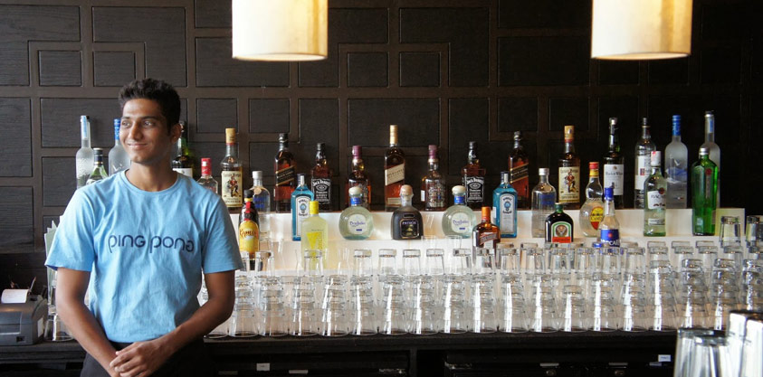
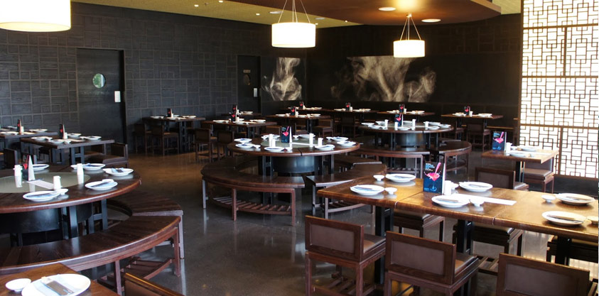
(Click on the image / spacebar to view photo gallery)
Restaurant
Architect: Mach Architektur Zurich
www.rajinterior.co.in | info@rajinterior.co.in
25

Slide 28
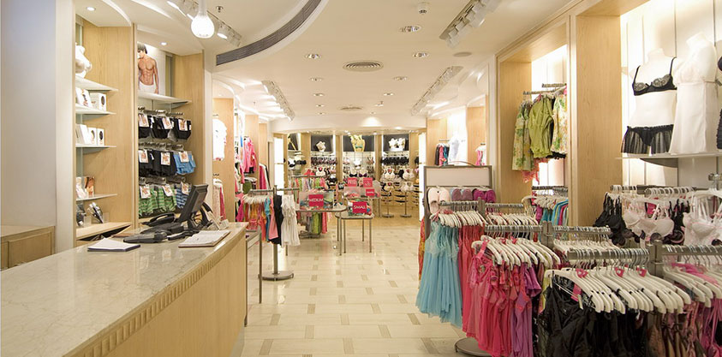
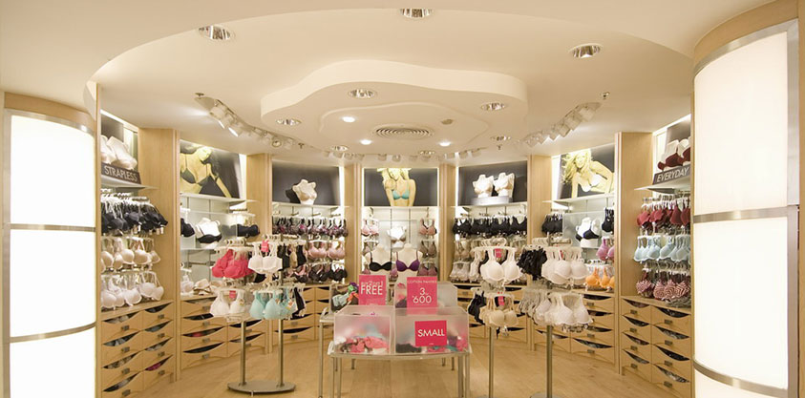
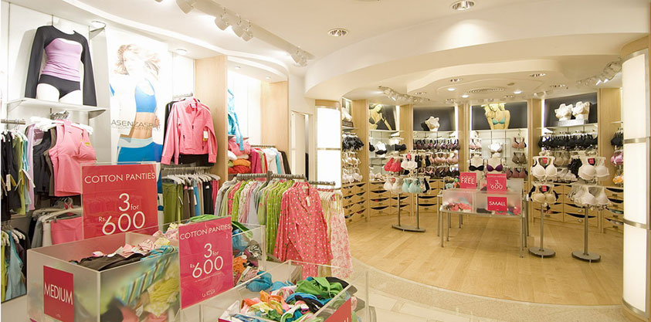

(Click on the image / spacebar to view photo gallery)
Architect: IMA, Singapore
www.rajinterior.co.in | info@rajinterior.co.in
26

Slide 29

Pursuit Of Client Contentment
No project is too small or too big for us. We ensure that each and every image and visualization in the minds of our clients is brought on the walls and bricks in the most stunning way. A considerable amount of time, energy and passion is invested to pave the way for the perfect look and feel.
Attention to Detail
Conceptualization of a plan is no doubt difficult. However, effectuating it is furthermore challenging. Bearing in mind our ‘zero scope to compromise theory,’ we emphasize on attention to detail and hence, bring out the ultimate finished look.
Functional
Abreast of the latest technological advancements and developments, we create ergonomically designed spaces ensuring productivity and lastingness.
www.rajinterior.co.in | info@rajinterior.co.in
8

Slide 30

At Raj Interiors, we reckon on magnificence, and hence have construed a value driven process.
We envisage your vision and aim to convert it into a living reality.
ACHIEVING
OPERATIONAL
EXCELLENCE
www.rajinterior.co.in | info@rajinterior.co.in
4

Slide 31




Mr. Fateh Singh | Director
The Director, Mr. Fateh Singh, is a personal who have toiled hard to achieve recognition-recognition as a good contractor. After years of functioning at a grass root level, a vision was foreseen. This lead to giving a corporate look to the family business.
Values
Values
We envisage a beautiful world. We wish to catch a glimpse of this beauty in the eyes of our clients by fabricating a world that is fascinating and marvelous. We intend to be the one setting the benchmark for designing and we are aware that all this could be attained only via happy clients.
Adhering to the highest ethical and moral standards, we are always committed to instill values of quality and bring out the individuality of our interiors. We also ensure that all the environmental issues are taken into consideration and work in a socially responsible and ethical manner.

Slide 32


Team
Raj Interiors was founded, with a combined experience of its director and is now spearheaded by his two sons Raj Attar and Rajesh Attar. We embrace the vision that comes our way to the ultimate satisfaction of the architect and the clients.

Slide 33

QUALITY
IS THE KEY
Quality assurance is at the heart of our philosophy.
While we have been majorly dealing with beautifying majestic restaurants and homes with plush designs, we are particular about our quality standards. We ensure that our policies and regulations are incorporated at every step.

Slide 34

TALENT,
SKILL & CREATIVITY
We understand every component of a design matters and hence, leave no stones unturned in offering the absolute look and appearance. Without compromising on the standards, we endeavor to offer you the best solution at the minimal budget, swiftly and proficiently.

Slide 35
Contact
Address:
Raj Interiors T/250/6, Old Barrack,
Behind Building No. 32,
Chembur Colony
Mumbai - 400074
T: 02227640043 / 47
M: 918097751247
E: info@rajinterior.co.in
www.rajinterior.co.in | info@rajinterior.co.in
29

Slide 36

Thanks
www.rajinterior.co.in

